Slide 1


Ultrasound in MTN-016
Lisa Noguchi, PhD
MTN-016 Training
Notes:
1

Slide 2

Why Ultrasound in MTN-016?
Performed properly, an accurate method of determining gestational age (GA)
Fetal anatomy assessed adequately after ~18-20 weeks GA, with some individual variation
  MTN-016 prefers 20-28 weeks for anatomy scan
Both dating and anatomy important for understanding potential impact of drugs in pregnancy
  Understand timing of exposure and potential impact on intrauterine growth/development
Notes:
Guidance on U/S: pages 49-50 of protocol
2

Slide 3
Ultrasounds at Your Site
Who here has performed obstetric ultrasound?
  Which trimesters?
  Will you perform any obstetric ultrasound in MTN-016?
How is ultrasound ordered at your site?
  Where is it performed?
  Standard form or handwritten order?
  How are results communicated?
Notes:
3

Slide 4
If Study Site Orders the U/S
Have the UR-1 CRF on hand when you fill out or write your order!
  If feasible, consider a new preprinted order format for MTN-016 participants
Clearly request of the ultrasound provider
  Gestational age determination
  If estimated GA by LMP is >18 weeks, request evaluation of all components of anatomy that are listed on the CRF
Notes:
4

Slide 5
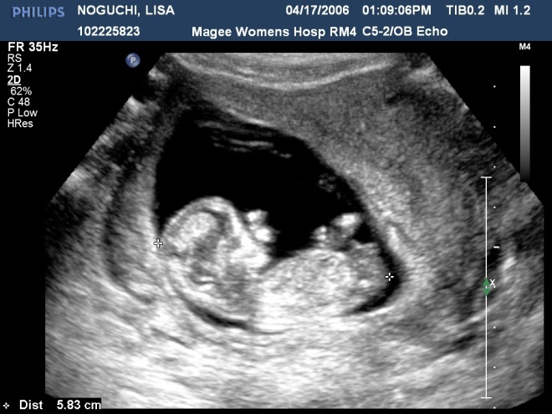
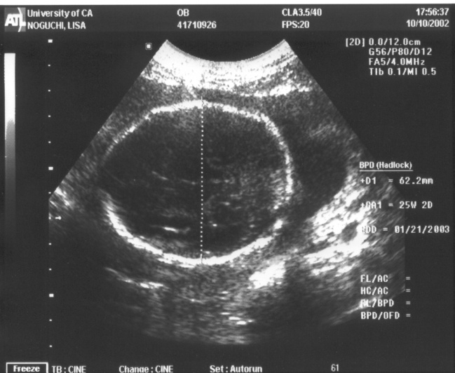
Gestational Age Determination
  GA determination most accurate in first half of preg.
    First trimester crown-rump measurement is most accurate for U/S dating
    Order first trimester U/S when LMP unknown or when size/dates do not match
Pregnancy should not be “re-dated” after dates are calculated from an accurate earlier scan
CROWN RUMP LENGTH (CRL)
BIPARIETAL DIAMETER (BPD)
Notes:
Other indications for first trimester ultrasound = evaluate suspected ectopic, vaginal bleeding, pelvic pain, confirm cardiac activity, etc.
5

Slide 6
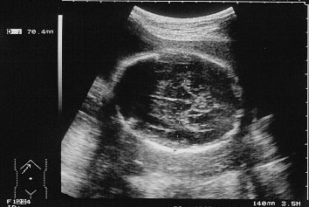
Biparietal Diameter
Technically more challenging than CRL
Measure at level of thalami and cavum septi pellucidi
Cerebral hemispheres should not be visible in this scanning plane
Measure from outer edge of proximal skull to inner edge of distal skull
In this image, BPD = 70.4 mm
Notes:
Midline falx should be visible. Thalami should be symmetrical. Scanning in the wrong plane can cause errors of up to 20 mm!
6

Slide 7
When to Change Dates?
In general, U/S-established dates take preference over menstrual dates when discrepancy is greater than:
  7 days in the first trimester
  10 days in the second trimester (up to 20 weeks gestation)
Reassigning GA in the third trimester should be done with great caution – accuracy is only within 3-4 weeks
Notes:
Variability of GA estimation increases with advancing pregnancy
7

Slide 8
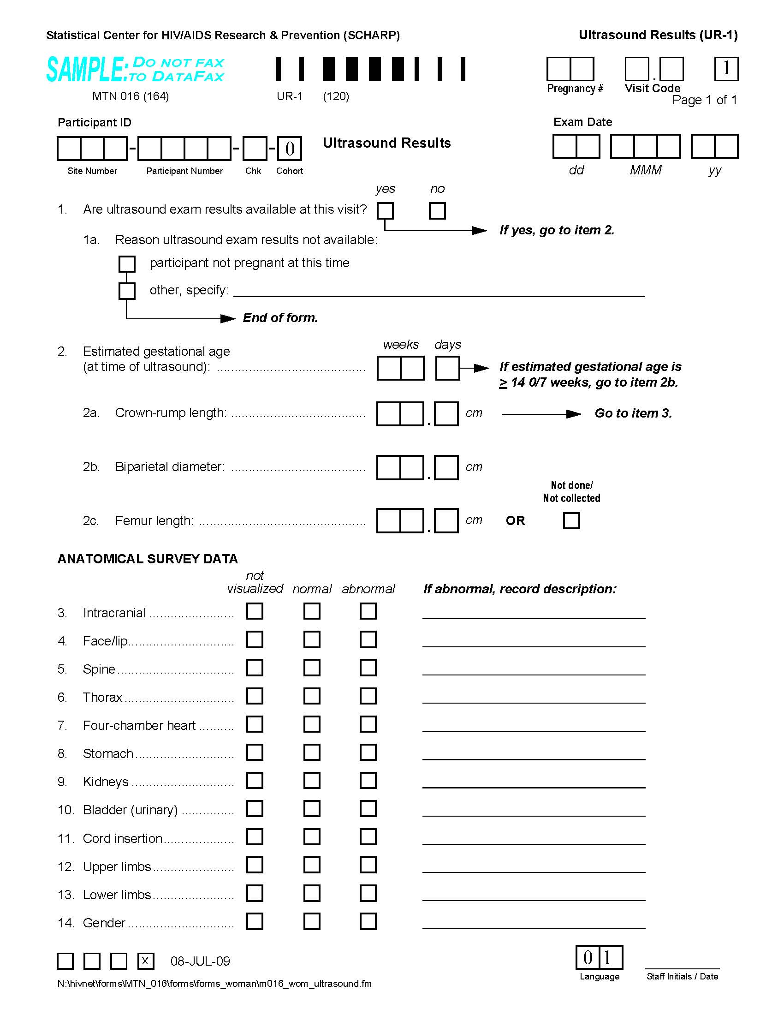
Ultrasound Results (UR-1)
Complete/fax to SCHARP at Enrollment and each completed Quarterly visit
“Pregnancy #” refers to number of pregnancy corresponding to MTN-016 participation, NOT her Gs and Ps
Exam Date = date U/S is completed, NOT date reviewed
Item 2a: Complete if GA at time of U/S is < 14w 0d
Items 2b and 2c: Complete if GA at time of U/S is ≥ 14 w 0d
Items 3–14: For each item marked “abnormal,” record description
Notes:
Ultrasound Results (UR-1) used to document results for each U/S completed during pregnancy
8

Slide 9
What if Ultrasound Report is Incomplete?
Contact the ultrasound provider
  Are images or video still available?
  Can a revised report be sent to the site?
If a revised report is not available, order another ultrasound, when possible, and specifically request evaluation of the missing items
Set up routine expectations and establish a line of communication with your ultrasound provider, when possible
Notes:
Protocol (page 49) allows for ordering repeat ultrasound to confirm GA or provide f/u information on potentially abnormal findings.
9

Slide 10
What if Results are Abnormal?
Communication!
  With participant’s obstetric care provider
  With the participant – discuss communication strategy with obstetric care provider
  With the MTN-016 Management Alias and DAIDS Medical Officer
Clinically appropriate follow-up plan – consult if results are abnormal/unclear
Source documentation
Notes:
10

Slide 11
A Few Last Words…
Order/perform to the CRF, at a minimum
Get comfortable with ultrasound abbreviations and terminology used at your site
If you can only get one…the ideal single ultrasound in MTN-016 is a dating confirmation and thorough anatomical survey at about 20 weeks gestation
Protocol allows for multiple ultrasounds, if necessary
Send your ultrasound questions to the MTN-016 Management Alias and DAIDS Medical Officer
Notes:
11

Slide 12
A Few Different Scenarios
Report is reviewed and states only “normal IUP at 18 2/7 wks”
Report states “normal IUP at 22 wks except marginal placenta previa”
Images reviewed and BPD looks like it was measured in the wrong plane
Notes:
Compare this report with the UR-1 CRF. Many elements are missing. Refer to slide 9: What if Ultrasound Report is Incomplete?
This is not an emergency at the moment and may be seen in 1-15% of pregnancies. However, some counseling for the participant is in order (by her antenatal care provider). There is some debate regarding how often to repeat ultrasound in this case. Refer to Slide 10: What if Results are Abnormal?
This is tricky because you don’t want to alienate an ultrasound provider. Options include repeating the ultrasound with another (or the same) provider – fetal movement may have prevented getting a good measurement), or sending a query to the MTN-016 management team. The management team will consult with Protocol Chairs and DAIDS MO. In this case, a deidentified copy of the image and report is highly useful.
12

